Slide 1

Southwestern University of Finance and Economics Research Institute of Economics and Management Factsheet: Study Abroad & Exchange 2025-2026
Contact Information for incoming exchange students
 | Inbound | Outbound
Name | Ms. Juan Cheng | Ms. Qian Ni
Email | chengjuan@swufe.edu.cn Juangheng2016@qq.com | niqian@swufe.edu.cn
Tel | +86 28 87098243 | +86 28 87092471
Postal address
Southwestern University of Finance and Economics No.555, Liutai Avenue, Wenjiang District, Chengdu, Sichuan, 611130, P.R.China
Visiting address
中国四川省成都市温江区柳台大道555号西南财经大学
Southwestern University of Finance and Economics No.555, Liutai Avenue, Wenjiang District, Chengdu, Sichuan, P.R.China
Website
General website of the University https://e.swufe.edu.cn/
Website of SWUFE RIEM https://riem.swufe.edu.cn/international.htm
Campus life and Services https://international.swufe.edu.cn/English/Campus_Life_and_Services.htm
Online Application System for International Students https://swufe.17gz.org/
Useful information about living in Chengdu http://www.chengdu.gov.cn/english/ https://www.gochengdu.cn/en

Slide 2

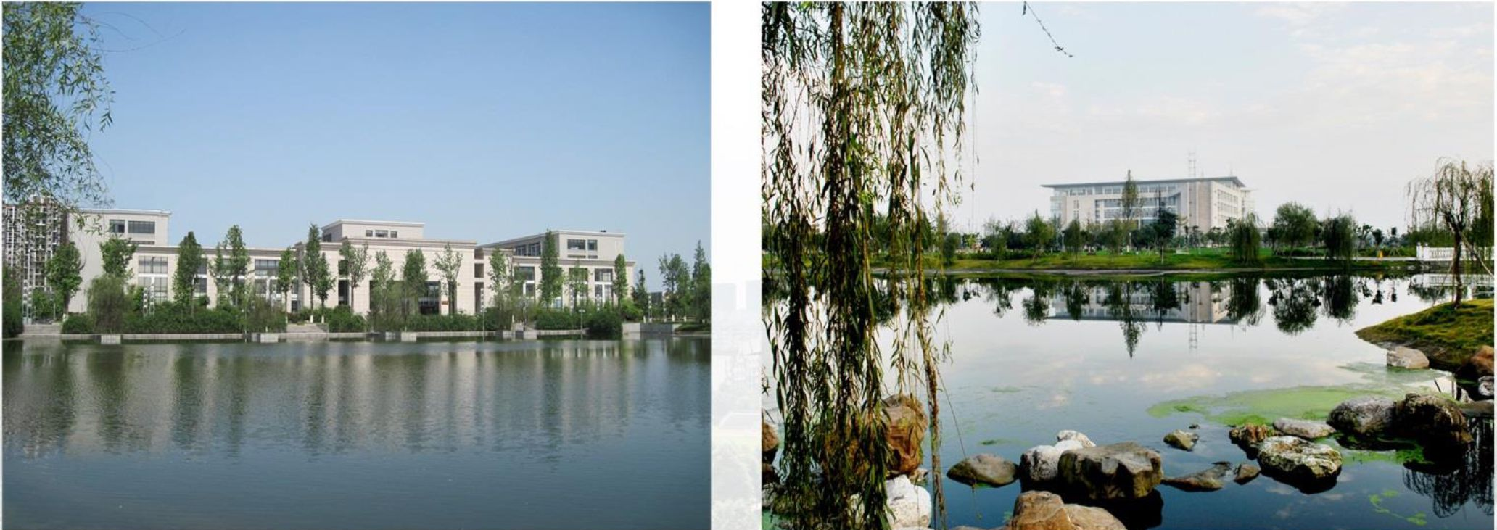
About SWUFE
The Southwestern University of Finance and Economics (SWUFE) is a top university specialized in finance, economics, and business. It is known for its entrepreneurial character and unremitting endeavors to address the needs of the people and society through academics, research, and influence on alumni, drawn from the legacy of its founders and generations of excellent alumni. SWUFE is located in Chengdu, the engine-city for the development of Western China and the fourth-largest aviation hub in China.
130+ International Partners in 36 Countries and Regions 3.8 Million Volumes' Library 380 Acres' Campuses 7 Research Institutes and Centers 20 Schools and College 2,000+ Faculty Members 24,000+ Students
About RIEM
The Research Institute of Economics and Management (RIEM) at SWUFE was established in 2006. Dedicated to high-quality teaching and research in economics, finance, and management, RIEM’s goal is to become an internationally-acknowledged research center as well as a leading Chinese think tank.
RIEM is a highly internationalized institute. All of RIEM’s faculty members hold doctoral degrees from well-established universities all over the world, including the U.S., the U.K., Australia, Canada, France, and Singapore. Their publications have appeared in respected international journals. All the courses in RIEM are taught in English. Currently there are more than 1000 students studying at RIEM, including 30% international students come from all over the world.

Slide 3

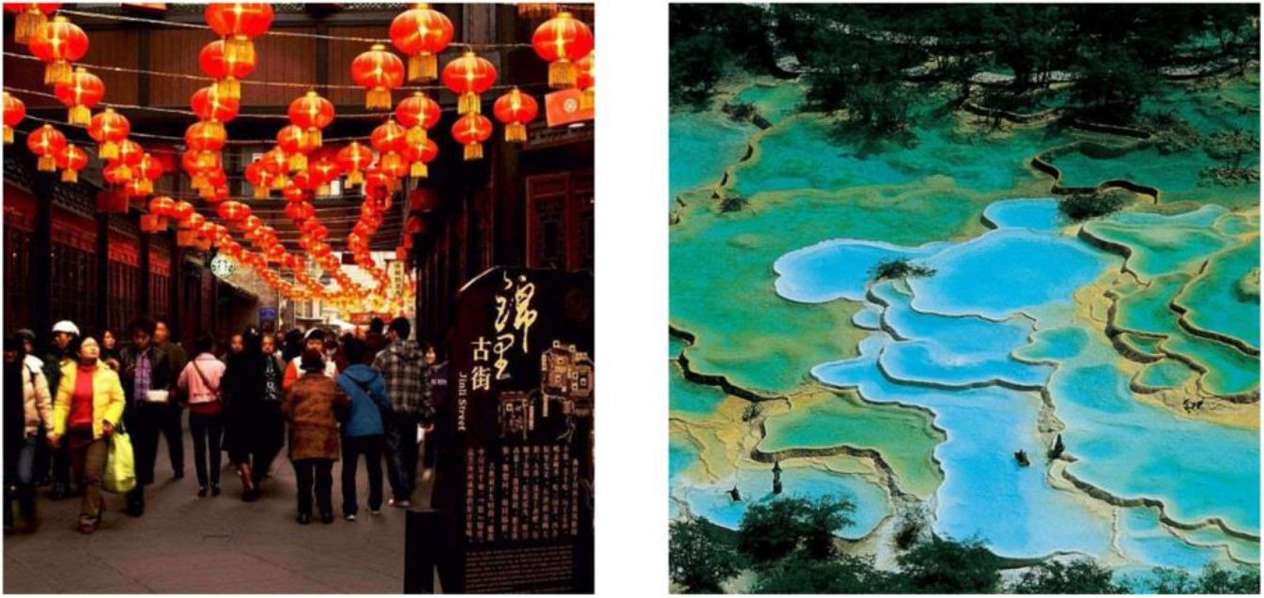
About Chengdu
According to written history, the construction of Chengdu stayed as early as over 2,300 years ago. It is a city whose name has never been changed and which has never been relocated throughout history. According to history, Chengdu (literally, becoming a city) was named because "it grew into a settlement after one year's development, a county after two years' development and a city after three years' development." This city has nourished splendid culture in its over 2,000 years' development course. Chengdu, the Land of Abundance, has nourished splendid and time-honored culture in its development course of over 2,000 years. It has long been a charming city. Marco Polo once defined it as a "prosperous city" which made people linger on with no thought of leaving.
Today's Chengdu, apart from its unique historic and cultural charm, begins to project an air of magnificence as a major city in China. Chengdu now serves as the economic center, the science and technology harbor, the international exchange center, the cultural innovation city and the transportation hub of western China.
Chengdu is the hometown of Panda.
Campus Life and Living expenses
Academic, Residential, Social and recreational facilities are within walking distance on campus. Most classrooms have built-in multi-media facilities and offer Wi-fi connections.
Books and Supplies | <500 CNY/Term
Accommodations | 600 – 800 CNY/Month (On-campus dorm) 800 – 1800 CNY/Month (Off-campus)
Food | 1000 – 2000 CNY/Month
Transportation | 50 – 200 CNY/Month
Other(internet, cell phone) | 200 CNY/Month(approximately)

Slide 4
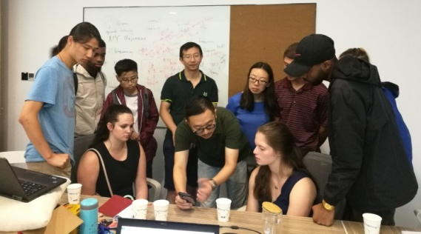
Academic Calendar
In SWUFE, fall and spring terms last for 19 weeks respectively, including 17 teaching weeks and 2 examination weeks. Summer term lasts for 2 weeks. Every year the school calendar changes according to the different Chinese official holiday arrangement, but usually Fall Term begins in early September to early January, Spring Term from late February to late June and Summer Term is in July.
2025-2026 Academic Year
Fall Semester – Start/end dates: | Early September – Early January
Spring Semester – Start/end dates: | End of February – End of June
Course Information
RIEM offers a broad variety of undergraduates and graduate level courses to exchange students. We offer courses within the fields of Economics, Finance, Accounting, and Business Administration for undergraduate level. Offer course within fields of Economics, Finance, and Enterprise Management for graduate level. And offer Chinese Mandarin Course for all the international students.
Teaching Language will be English
Undergraduate Level Course
Course for Economics | Course for BA | Course for Finance | Course for Accounting
Game Theory Environment Economics Health Economics Industrial Organization Theory Urban Economics Labor Economics Methods of Economic Research and Essay Writing Microeconomics Introduction to Finance Macroeconomics Intermediate Microeconomics International Economics Econometrics Intermediate Macroeconomics Financial Economics | E-Commerce Entrepreneurship Organizational Behavior Management Science Seminars Human Resource Management Operations Research and Information Management Marketing Principles of Management Probability Theory Chinese Economy | Corporate Finance Investment Household Finance Data Analysis and Statistics Software Financial Econometrics Computational Finance Financial Institutions Risk Management Derivative Pricing Monetary Banking Applied Finance | Accounting Financial Management Financial Statement Analysis Managerial Accounting Accounting Information System Financial Accounting Auditing

Slide 5
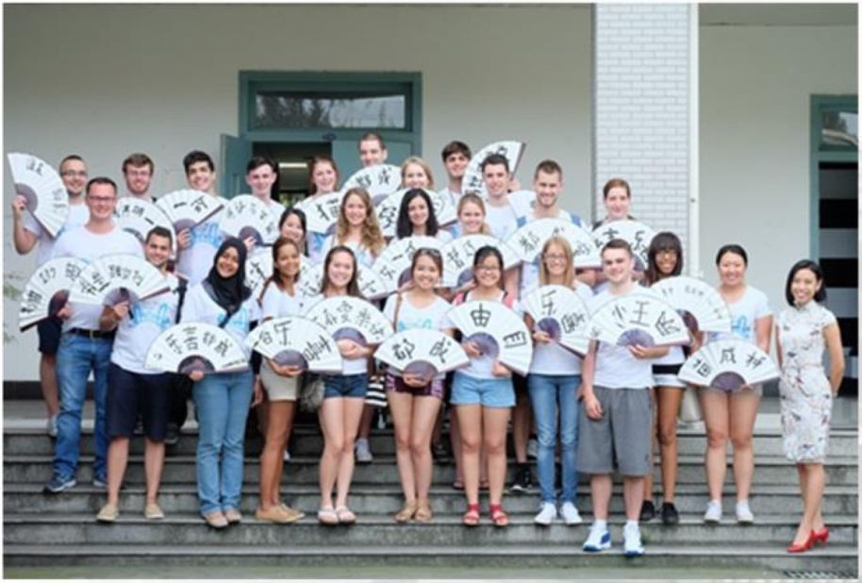
Graduate Level Course
Course for Economic | Courses for Management | Courses for Finance | Special course for International students
Advanced Econometrics Advanced Macroeconomics Advanced Microeconomics Applied Econometrics Applied Microeconomics Development Economics Economics Research and Practice Empirical Industrial Organization Environmental Economics Experimental Economics Game Theory Industrial Organization Theory International Economics Labor Economics Real Estate Economics Regional Economics Urban Economics | Advanced Management Advanced Operation Management Consumer Behavior Enterprise Innovation and Entrepreneurship Intermediate Management Management Modeling and Simulation Marketing Management Research Methodology and Writing Seminar on Management Science Strategic Management Operations Management Organizational Behavior | Mathematic Economics Advanced Investment Asset Pricing Corporate Finance Financial Econometrics International Finance Money and Banking Principles of Finance | China Panorama Chinese Economy Chinese Language
Grading system
Course grades are recorded based on 100-point system. Students must obtain at least 60 points in a class in order to pass and obtain course credit.
Grades, scores, and Grade Point Averages (GPA) are judged according to the following scale:
Scores | Grade | GPA
95—100 | A+ | 4.5-5.0
90—94 | A | 4.0-4.4
85—89 | A- | 3.5-3.9
80—84 | B | 3.0-3.4
75—79 | B- | 2.5-2.9
70—74 | C | 2.0-2.4
65—69 | C- | 1.5-1.9
60—64 | D | 1.0-1.4
59 below | E | 0

Slide 6
Important Date
 | Nomination Deadline | Application Deadline
Fall Semester and Full year | 30 April/every year | 30 May/every year
Spring Semester | 30 October/every year | 30 November/ every year
Admission & Registration
Procedure | Partner University nominates their selected students sending us their names, email address, study duration. To juancheng2016@qq.com or chengjuan@swufe.edu.cn within 20 March for Fall semester and 20 September for Spring Semester.
Application | All nominated students will receive an email with the application instructions and practical information about the exchange program at SWUFE. Students complete their application online. All the required materials need to be uploaded through the online application system, like transcript of records, copy of passport, and others. Here is the link for online application http://swufe.17gz.org
Acceptance Letter and Study Visa
A valid visa is the only official permit for your legal stay in China. Please monitor your visa status with great attention. To help you successfully apply for your study in China, SWUFE will send an acceptance letter and completed JW202 Form Student Pages to your home university.
The acceptance letter and JW202 form are supposed to be sent to all incoming students from the date below when they are ready. End of June for Fall semester nominations. End of December for Spring semester nominations.
Students need to apply for visa X1 or X2 for study in China. Within 48 hours of successful registration, students should register his/her living address at the local police station and complete all other visa-related procedures under the guidance of the RIEM office.

Slide 7
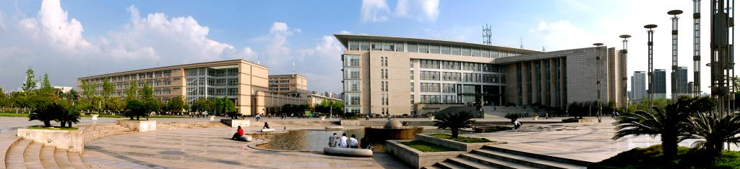
Campus Information
Guanghua Campus | Located at the west 2nd Ring in Qingyang District of Chengdu, standing next to Jinsha Bus Terminal, Guanghua campus is the old campus of SWUFE and currently holds continuing education and language teaching courses.
Liulin Campus | Located in Wenjiang District, Liulin campus is within 20 kilometers’ distance from downtown Chengdu and it is now the main campus where all undergraduates, graduates and Phd students study and live. There is a subway line 4 running between Guanghua campus and Liulin Campus every day.
Come to Chengdu
Students are required arrival at Chengdu before class start date. Students need take class in Liulin Campus. Address for Linlin campus in Chinese and English as below:
中国四川省成都市温江区柳台大道555号西南财经大学 Southwestern University of Finance and Economics, No.555, Liutai Avenue, Wenjiang District, Chengdu, Sichuan, P.R.China
Students who need airport pick-up service please contact RIEM office at least ONE WEEK prior to Airport Pick-up Days and make sure your fight will land at time 8 am to 8 pm. The pick-up service beyond 8 am to 8 pm will not be offered.
There are two airports in Chengdu, namely Chengdu Shuangliu International Airport (CTU) and Chengdu Tianfu International Airport (TFU). The two airports are connected by subway. You can reach the two campuses of SWUFE by subway.
Subway information The nearest subway station to Liulin campus is Wansheng, The nearest subway station to Guanghua campus is Cultural Palace. https://www.travelchinaguide.com/cityguides/sichuan/chengdu/subway-map.htm
Weather in Chengdu, check instant weather forecast of Chengdu by the link below: https://www.weather-forecast.com/locations/Chengdu/forecasts/latest

Slide 8
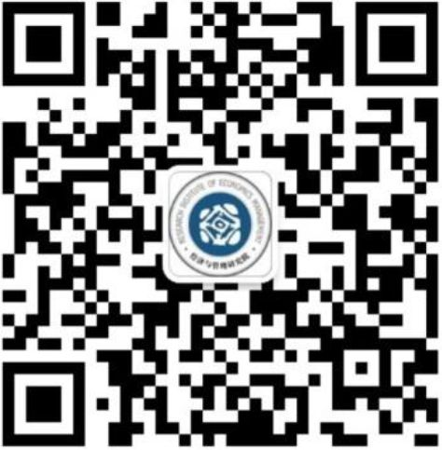
Insurance
It is mandatory for every international student to purchase a Compulsory Insurance designated by us. Upon registration, students are required to pay this insurance fee. Students who fail to pay the insurance fee cannot complete the registration and will be not allowed to extend visa or attend classes. If you already have bought insurance in China (which has to: cover the whole period of your stay in China, have effectiveness no lower than the insurance we designated) and submitted a photocopy of related documents, the Compulsory Insurance will be unnecessary. The Detailed clauses and information can be obtained at the office of RIEM.
Off-Campus Accommodation
SWUFE doesn’t provide a student residence for exchange students. However several rental agencies can help students in finding a suitable accommodation. Rent for a two-bedroom apartment with all necessary facilities will be around 1500-2500 CNY/month near Guanghua Campus or 1000-2000 CNY/month near Liulin campus
Real estate agencies for your reference.
Homelink Estate Tel:400-700-1001 http://cd.lianjia.com/zufang/wenjiangdaxuecheng/
Chengdu Zufang Tel: +86 28 86053666 https://cd.zu.fang.com/house-a0939/
Chengdu Real Estate Tel: +86 180 3070 8461 https://www.chengduapartment.com/
The above information is for reference only. SWUFE does NOT recommend any 3rd-party service providers or apartments.
Frequently Used Numbers 110 Police 119 Fire Department 120 First Aid

